Slide 1


ARYAN AARAV
2nd June 2023

Slide 2

Outline
Executive Summary
Introduction
Methodology
Results
Conclusion
Appendix

Slide 3
Executive Summary
Summary of methodologies
Data Collection
Data Wrangling
EDA with data visualization
EDA with SQL
Building an interactive map with Folium
Building a dashboard with Plotly Dash
Predictive Analysis(Classification)
Summary of all results
EDA results
Interactive analytics
Predictive analysis

Slide 4
Introduction
Project background and context
SpaceX advertises Falcon 9 rocket launches on its website, with a cost of 62 million dollars; other providers cost upward of 165 million dollars each, much of the savings because SpaceX can reuse the first stage. Therefore if we can determine if the first stage will land, we can determine the cost of a launch.
Problems you want to find answers
The problem is to predict if the Falcon 9 first stage will land successfully.

Slide 5

Section 1

Slide 6
Methodology
Executive Summary
Data collection methodology:
SpaceX REST API
Web scraping from Wikipedia
Perform data wrangling
One hot Encoding data field for Machine Learning and data cleaning of null and irrelevant columns
Perform exploratory data analysis (EDA) using visualization and SQL
Perform interactive visual analytics using Folium and Plotly Dash
Perform predictive analysis using classification models
LR, KNN, SVM, and DT models have been built and evaluated for the best classifier

Slide 7
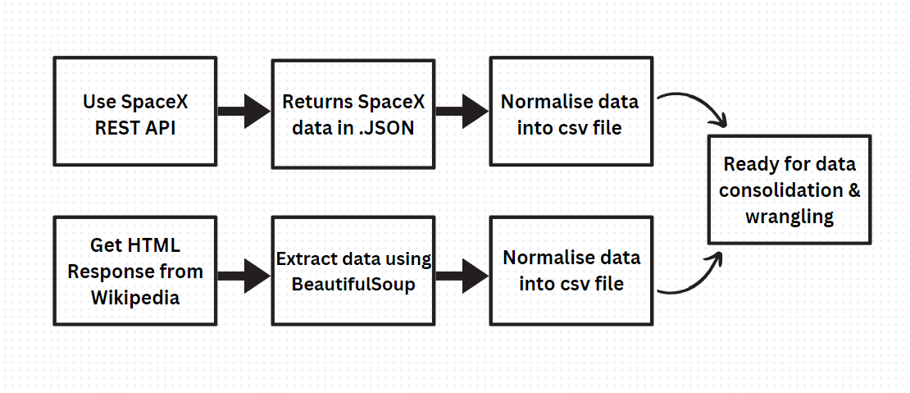
Data Collection
The following dataset was collected:
SpaceX launch data that is gathered from
the SpaceX REST API.
• This API will give us data about launches, including information about the rocket used, payload delivered, launch specifications, landing specifications, and landing outcome.
The SpaceX REST API endpoints, or URL, starts with api.spacexdata.com/v4/.
Another popular data source for obtaining Falcon 9 Launch data is web scraping Wikipedia using Beautiful Soup.

Slide 8
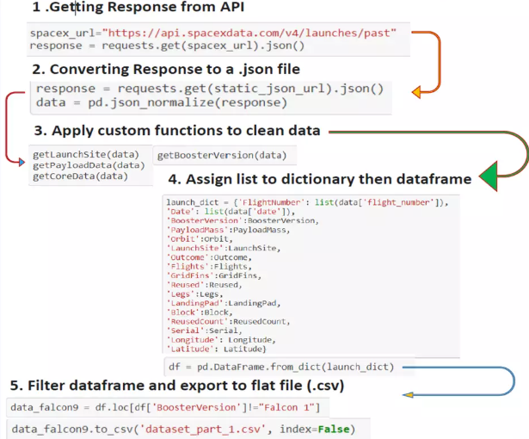
Data Collection – SpaceX API
Data collection with SpaceX REST calls
aa_repo/Data Collection API.ipynb at master · aryanaarav/aa_repo · GitHub
Place your flowchart of SpaceX API calls here

Slide 9
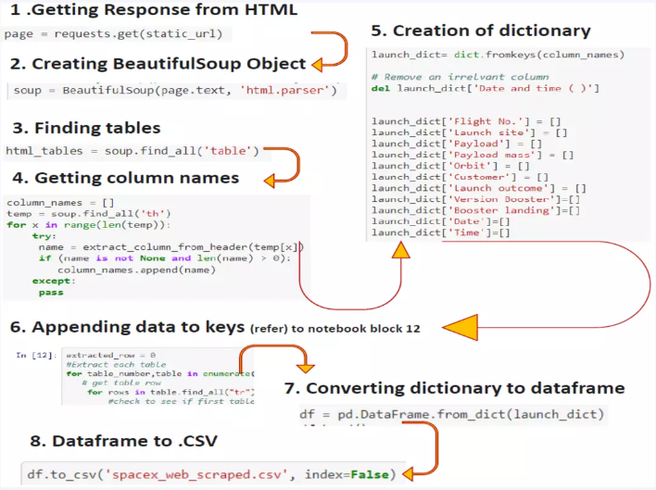
Data Collection - Scraping
Web Scraping from Wikipedia
aa_repo/Web Scraping Data.ipynb at master · aryanaarav/aa_repo · GitHub
Place your flowchart of web scraping here

Slide 10
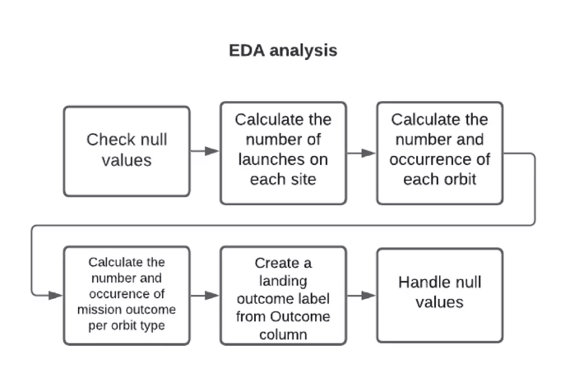
Data Wrangling
aa_repo/Data Wrangling.ipynb at master · aryanaarav/aa_repo · GitHub

Slide 11
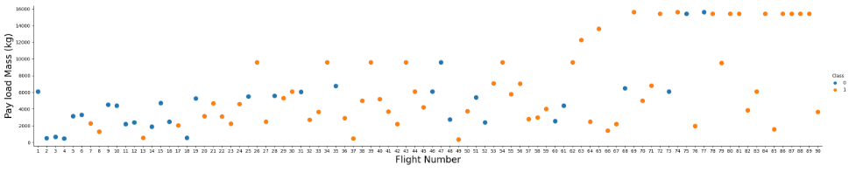
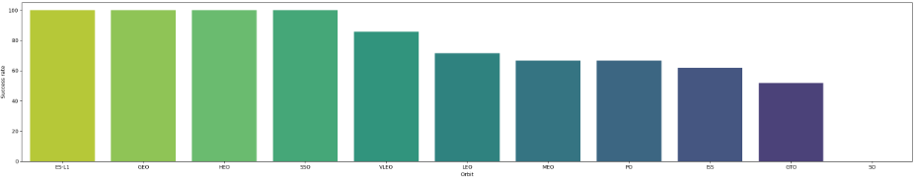
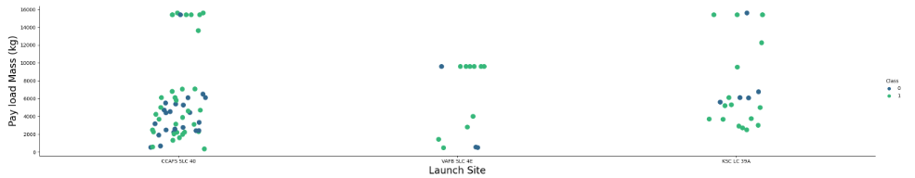
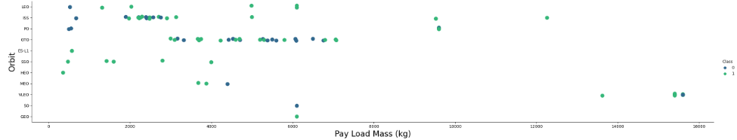
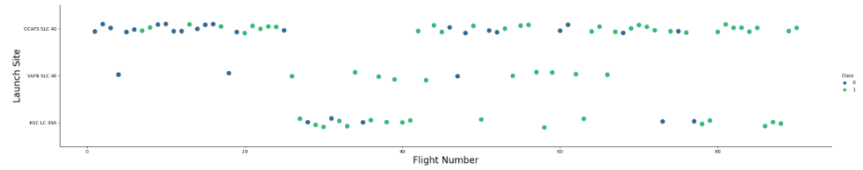
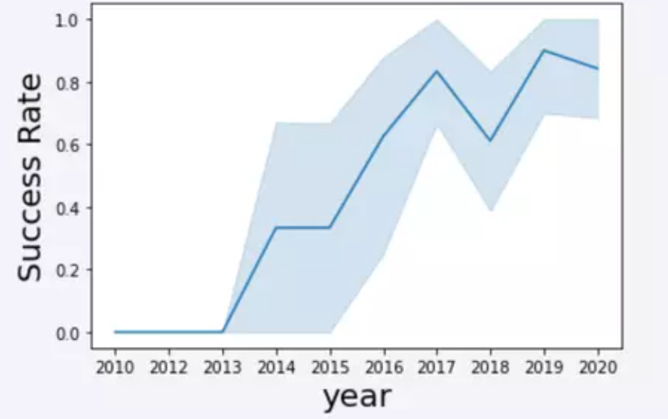
EDA with Data Visualization

Slide 12
EDA with SQL
SQL queries performed include:
Displaying the names of the unique launch sites in the space mission
Displaying 5 records where launch sites begin with the string ‘CCA'
Displaying the total payload mass carried by boosters launched by NASA (CRS)
Displaying average payload mass carried by booster version F9 v1.1
List the date where the successful landing outcome in the ground pad was achieved.
Listing the names of the boosters which have success in a ground pad and have payload mass greater than 4000 but less than 6000
Listing the total number of successful and failed mission outcomes
Listing the names of the booster_versions which have carried the maximum payload mass
Listing the records which will display the month names, failure landing_outcomes in the drone ship booster versions, and launch_site for the months in the year 2017
Ranking the count of successful landing outcomes between the date 2010 06 04 and 2017 03 20 in descending order.
aa_repo/SQL EDA.ipynb at master · aryanaarav/aa_repo · GitHub

Slide 13
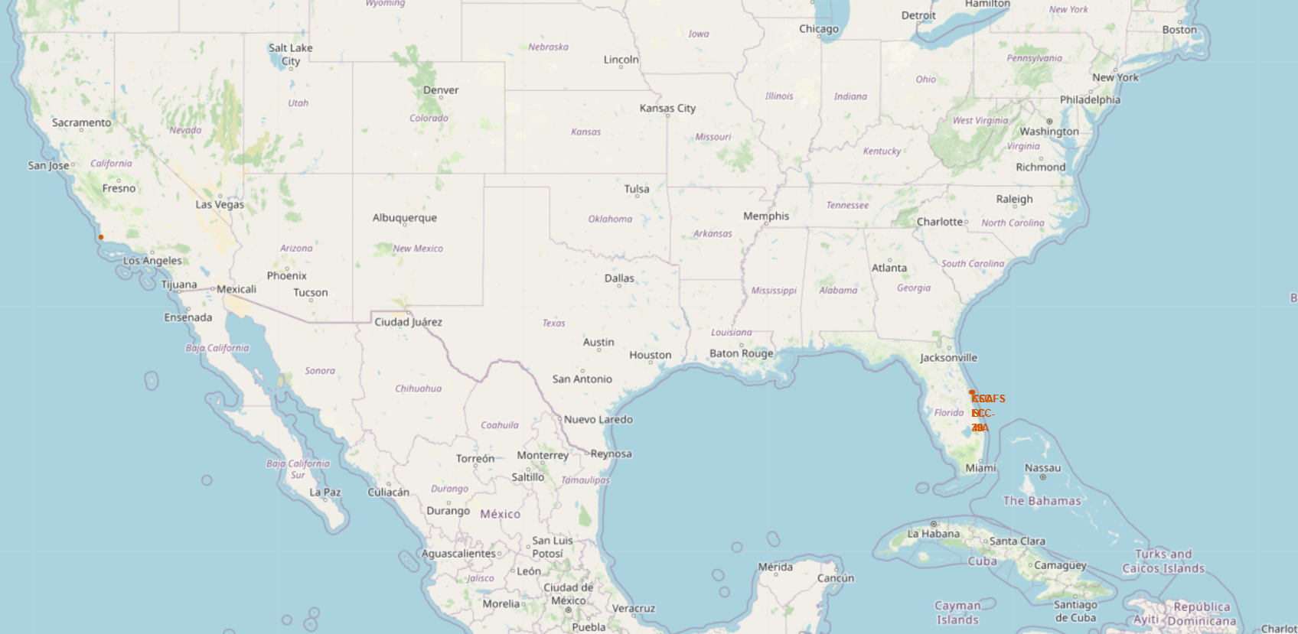
Build an Interactive Map with Folium
Map markers have been added to the map with the aim of finding an optimal location for building a launch site.
aa_repo/Location Analysis with Folium.ipynb at master · aryanaarav/aa_repo · GitHub

Slide 14
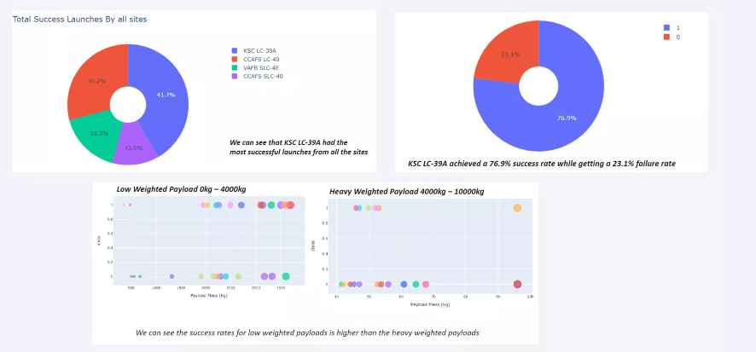
Build a Dashboard with Plotly Dash
aa_repo/Dashapp.py at master · aryanaarav/aa_repo · GitHub

Slide 15
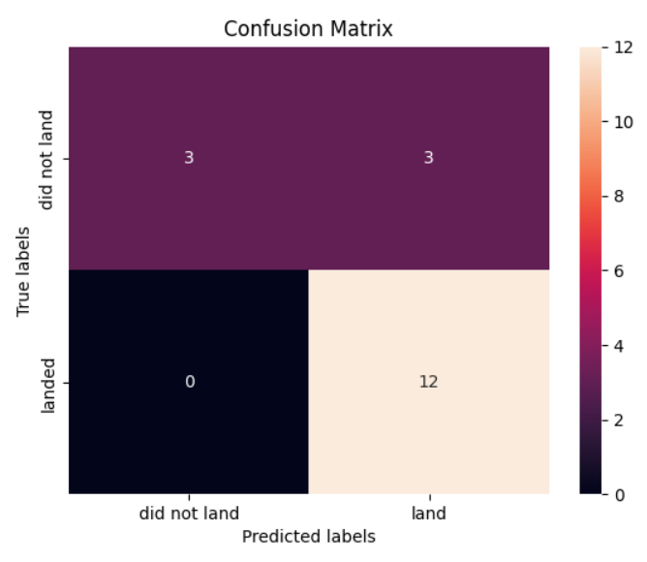
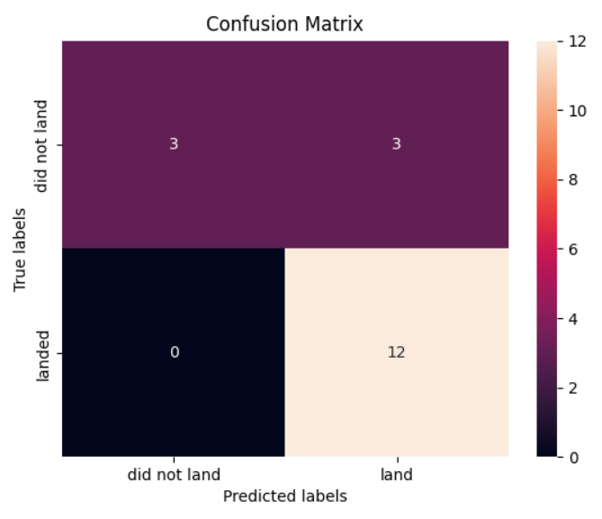
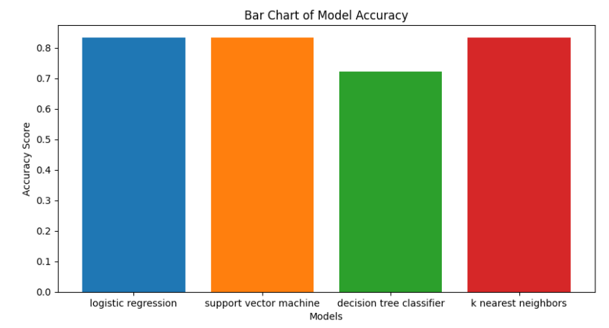
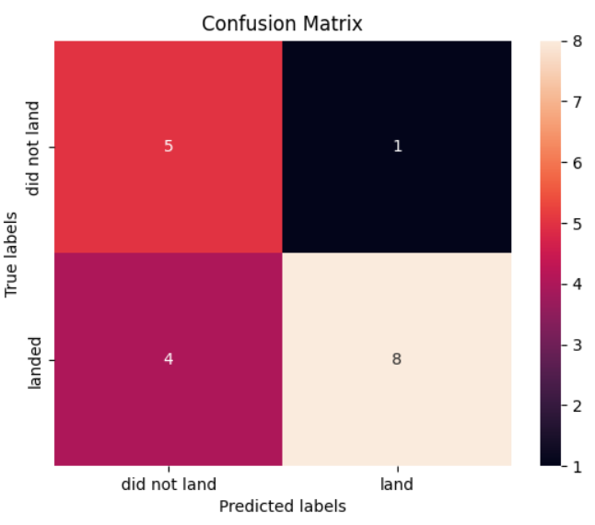
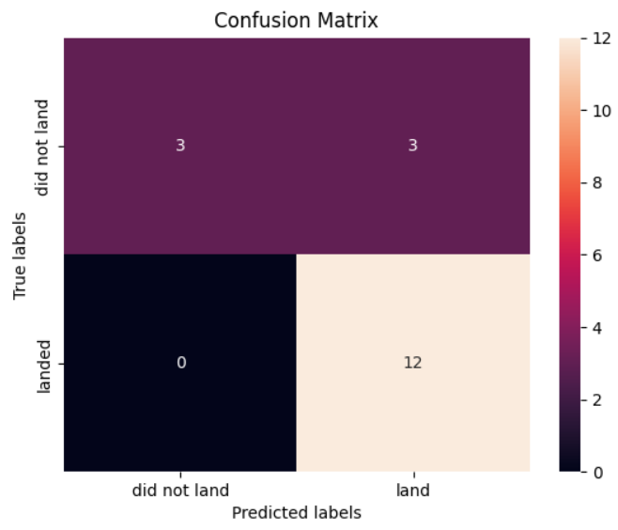
Predictive Analysis (Classification)
The SVM, KNN, and Logistic Regression model achieved the highest accuracy at 83.33%, while the SVM performed best in terms of Area Under the Curve at 0.958
aa_repo/ML predictions.ipynb at master · aryanaarav/aa_repo · GitHub

Slide 16
Results
The SVM, KNN, and Logistic Regression models are the best in terms of prediction accuracy for this dataset.
Low-weighted payloads perform better than heavier payloads.
The success rates for SpaceX launches are directly proportional time in years they will eventually perfect the launches.
KSC LC 39A had the most successful launches from all the sites.
Orbit GEO, HEO, SSO, ES L1 has the best Success Rate.

Slide 17

Section 2

Slide 18
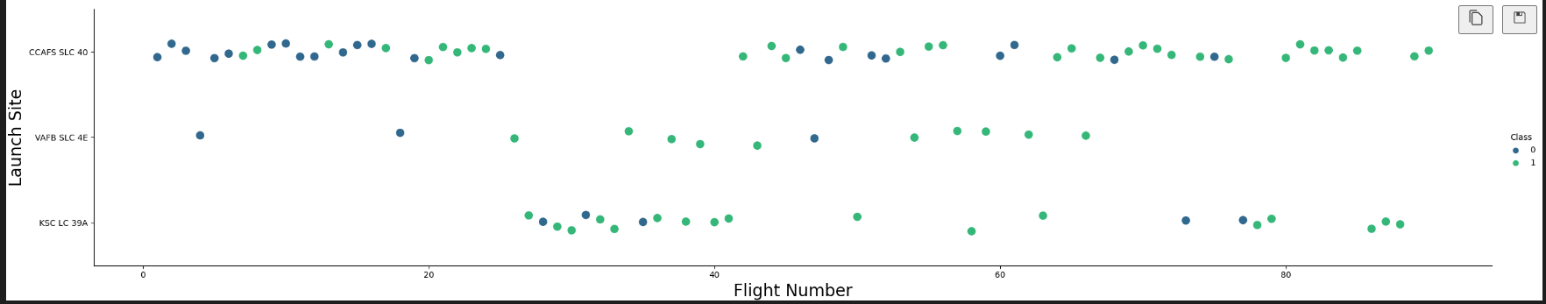
Flight Number vs. Launch Site
Launches from the site of CCAFS SLC 40 are significantly higher than launches form other sites.

Slide 19
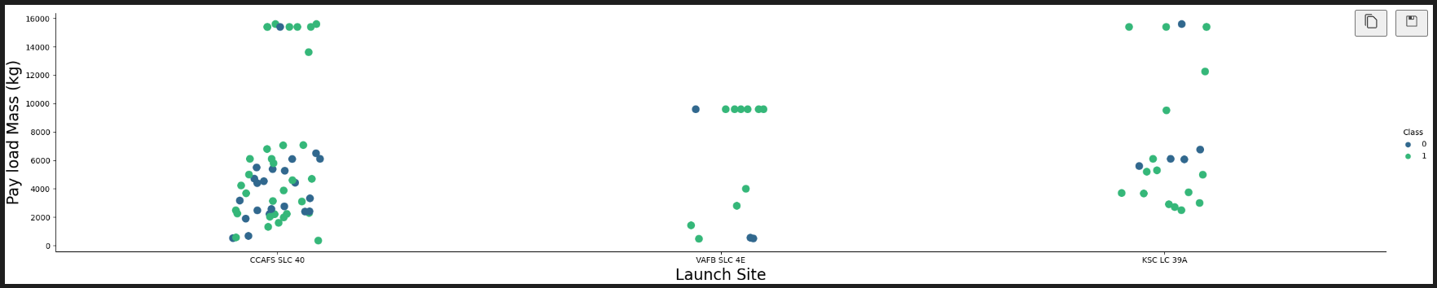
Payload vs. Launch Site
The majority of IPay Loads with lower Mass have been launched from CCAFS SLC 40.

Slide 20
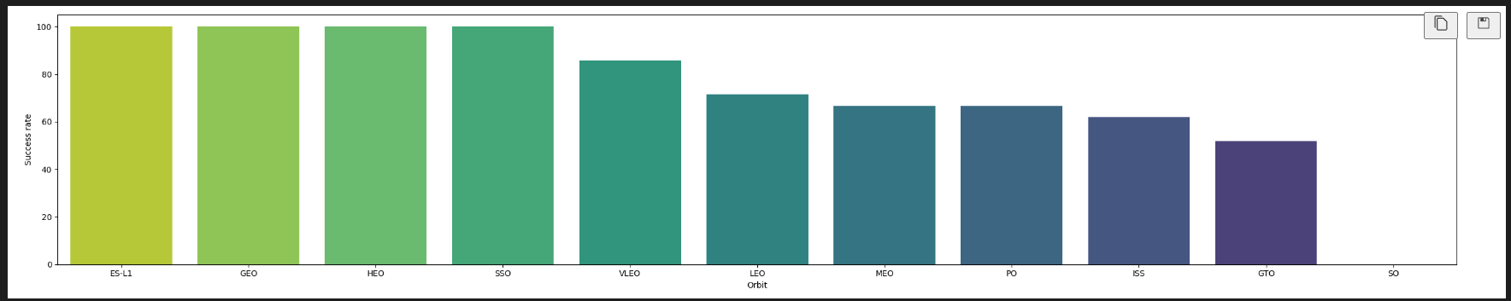
Success Rate vs. Orbit Type
The orbit type of ES-L1, GEO, HEO, and SSO are among the highest success rate.

Slide 21
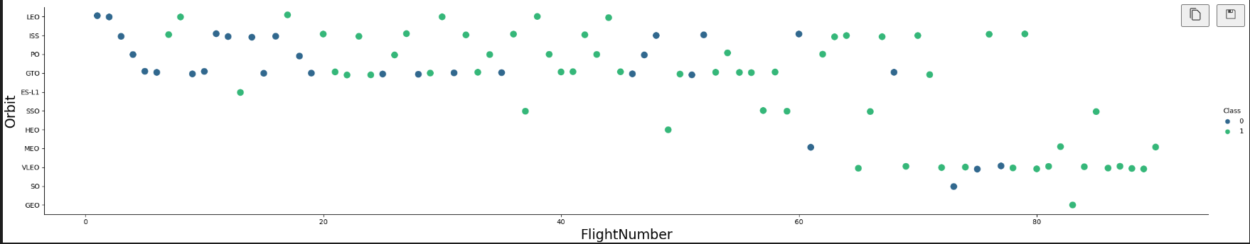
Flight Number vs. Orbit Type
A trend can be seen of shifting to VLEO launches in the recent years.

Slide 22
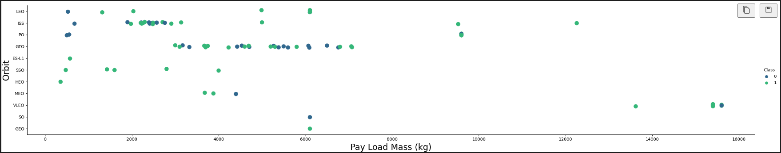
Payload vs. Orbit Type
There is strong correlation between ISS and Payload at the range around 2000, as well as GTO and the range of 4000-8000.

Slide 23
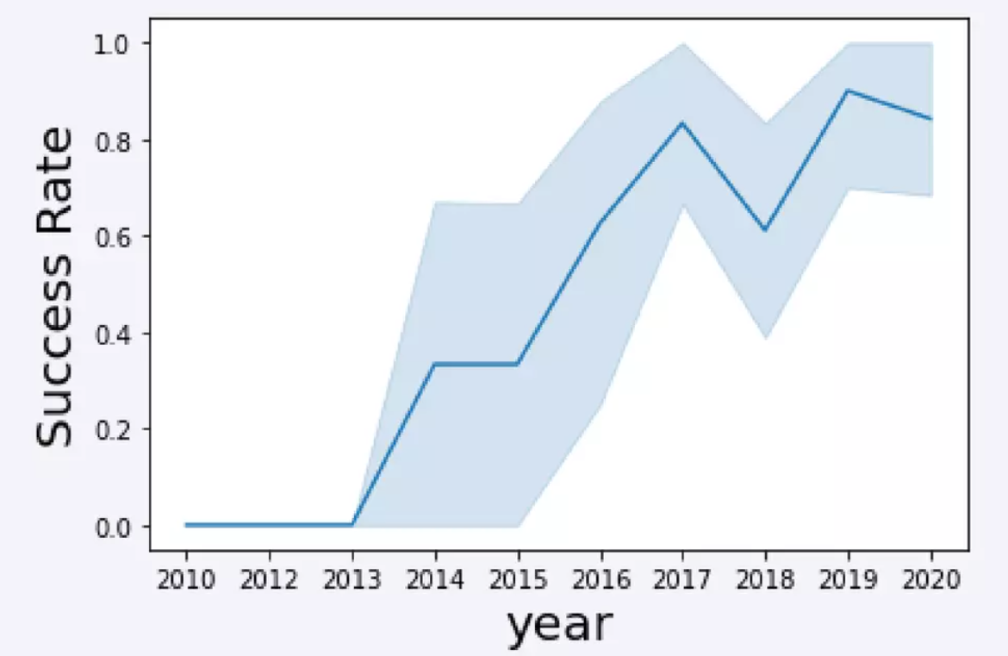
Launch Success Yearly Trend
The launch success rate has increased significantly since 2013 and has been established since 2019, potentially due to advancements in technology and lessons learned.

Slide 24
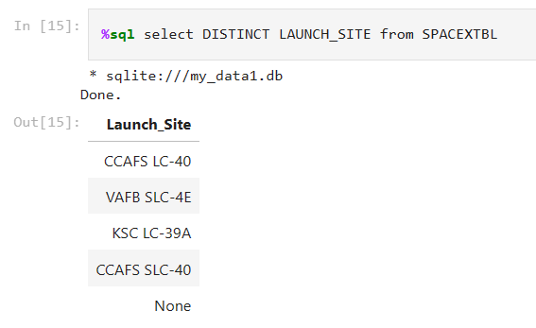
All Launch Site Names

Slide 25
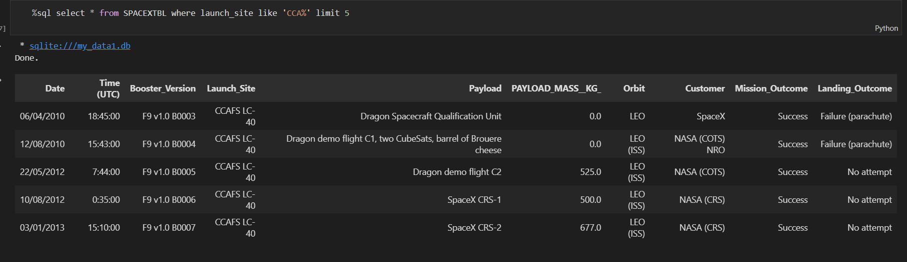
Launch Site Names Begin with 'CCA'

Slide 26
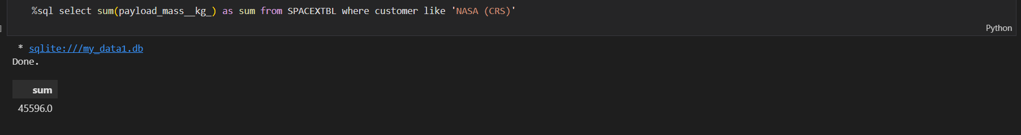
Total Payload Mass

Slide 27
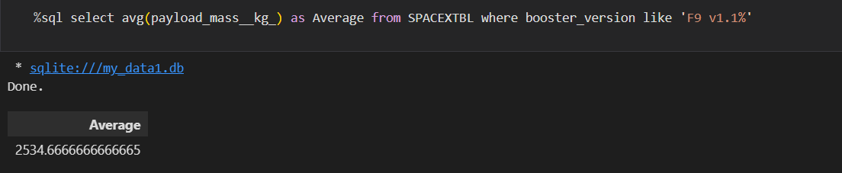
Average Payload Mass by F9 v1.1

Slide 28
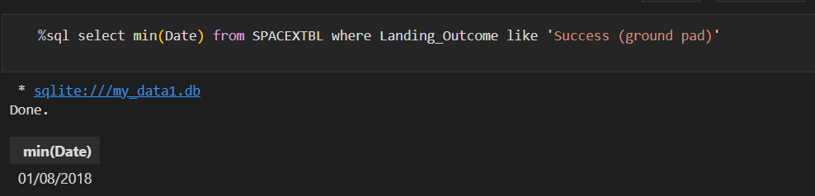
First Successful Ground Landing Date

Slide 29
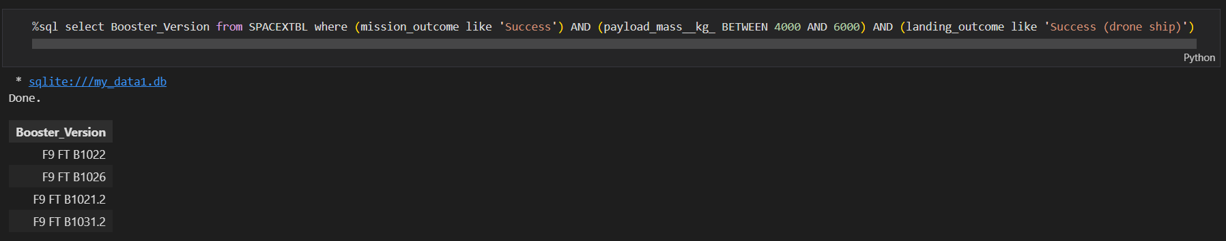
Successful Drone Ship Landing with Payload between 4000 and 6000

Slide 30
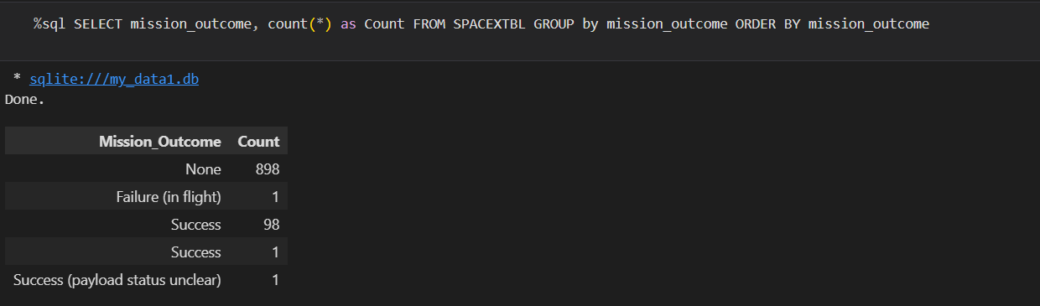
Total Number of Successful and Failure Mission Outcomes

Slide 31
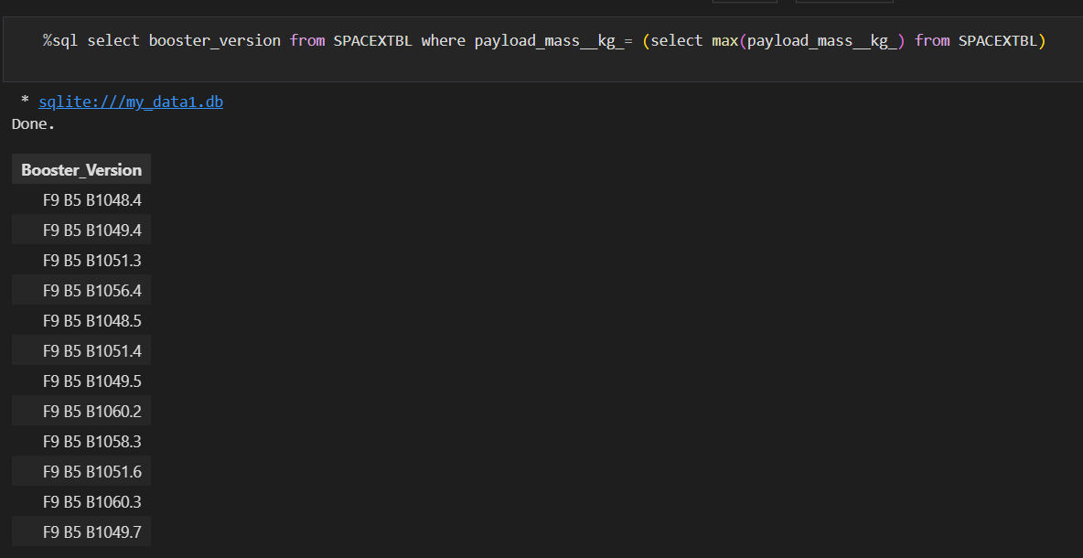
Boosters Carried Maximum Payload

Slide 32
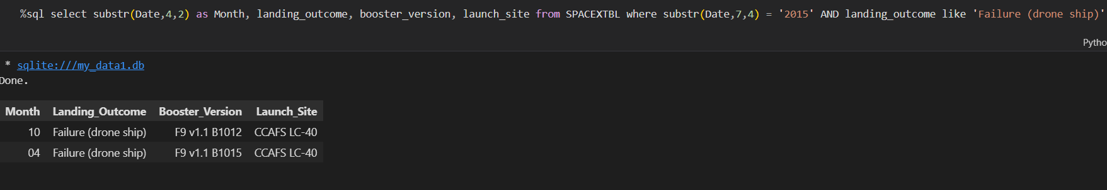
2015 Launch Records

Slide 33
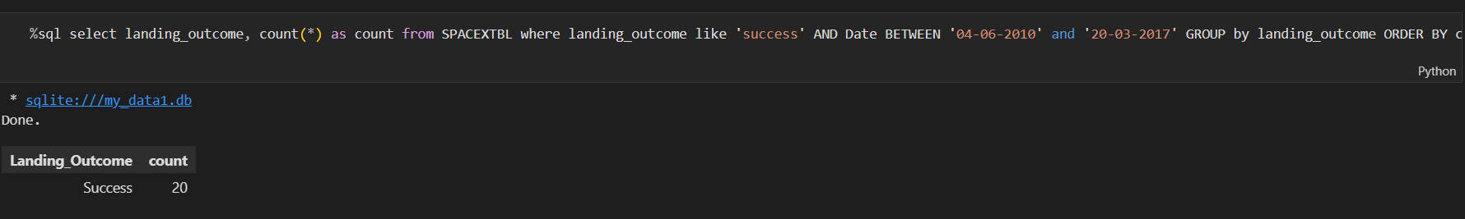
Rank Landing Outcomes Between 2010-06-04 and 2017-03-20

Slide 34

Section 3

Slide 35
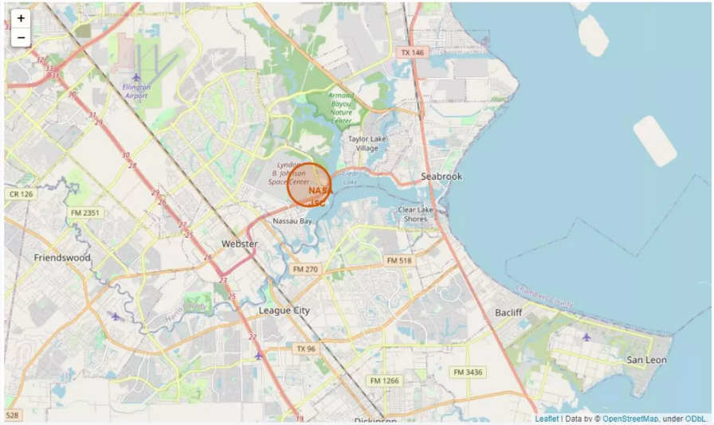
All launch sites marked on map

Slide 36
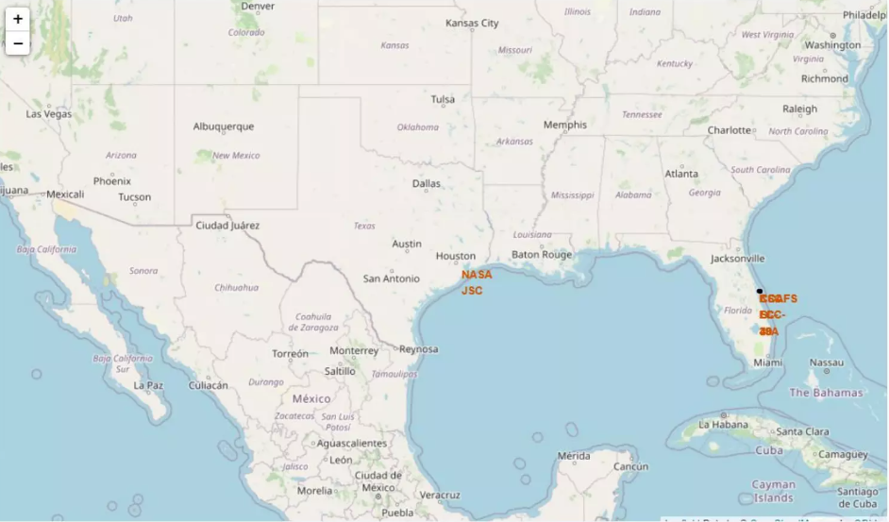
Success/Failed launched on the map

Slide 37
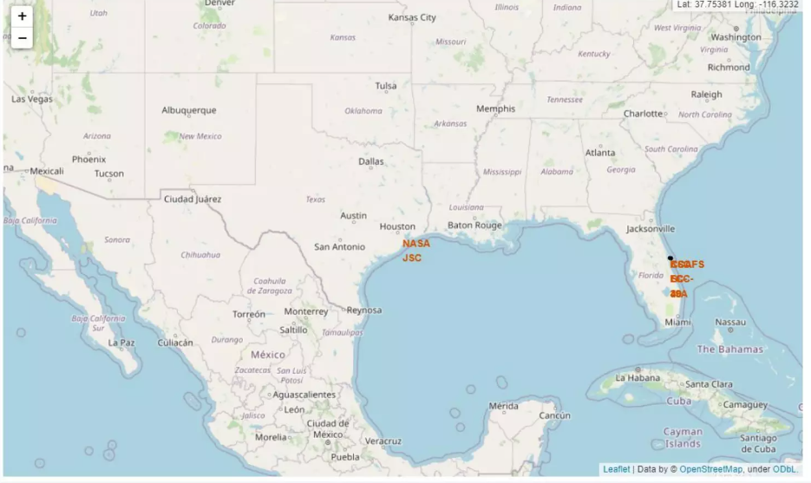
Distances between a launch sites to its proximities

Slide 38

Section 4

Slide 39
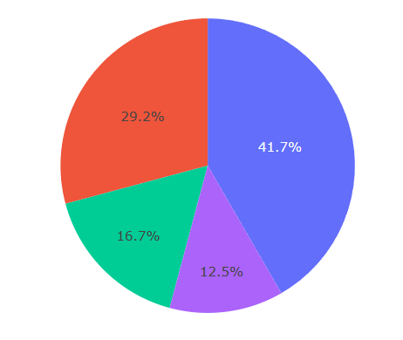
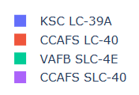
Total success launches by all sites
We can see that KSC-39A had the most successful launches out of all the sites.

Slide 40
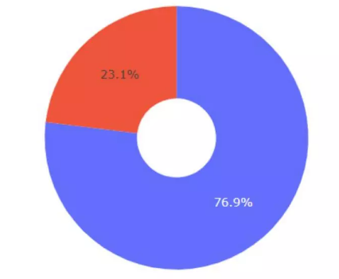
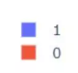
Success Rate by Site
KSC LC-39 achieved a 76.9% success rate while getting a failure rate of 23.1%.

Slide 41
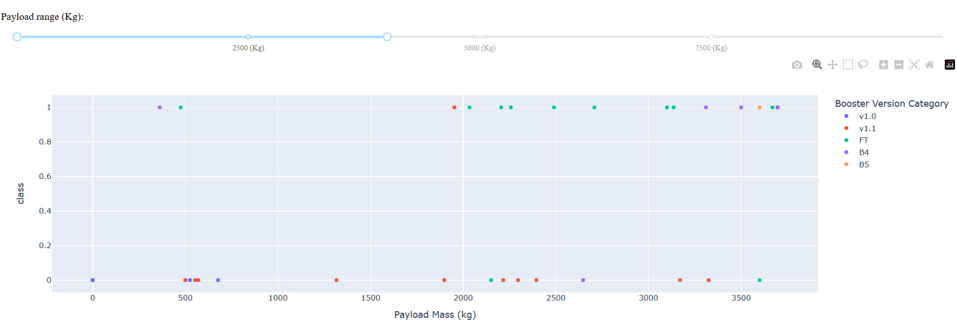
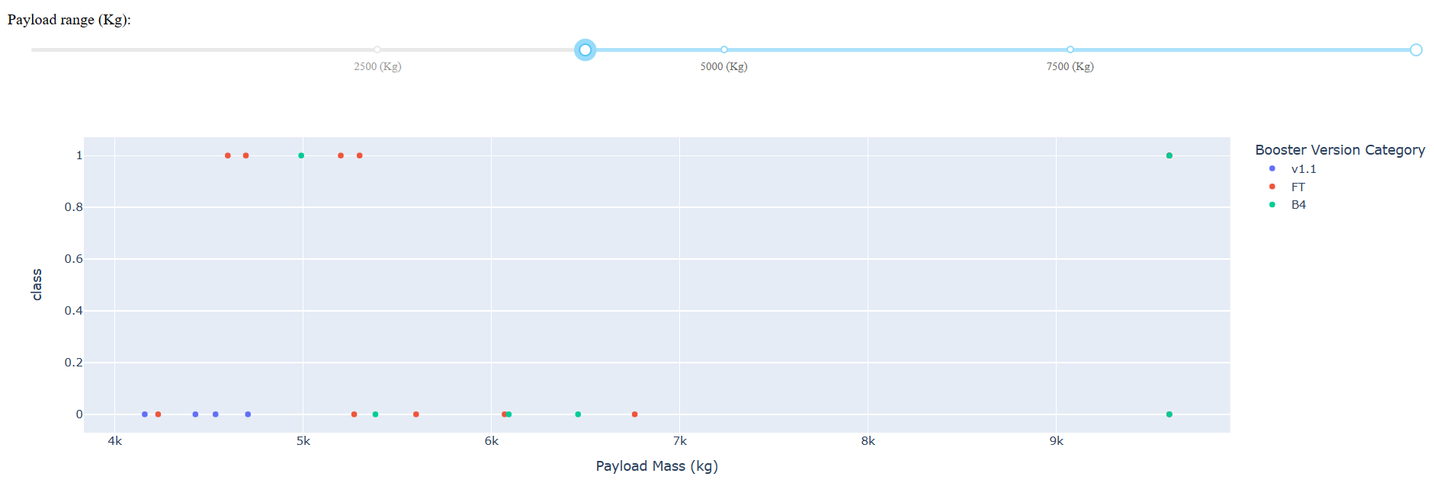
Payload vs Launch Outcome
We can see the success rate for low-weighted payloads is higher than the success rate of heavy-weighted payloads.

Slide 42

Section 5

Slide 43
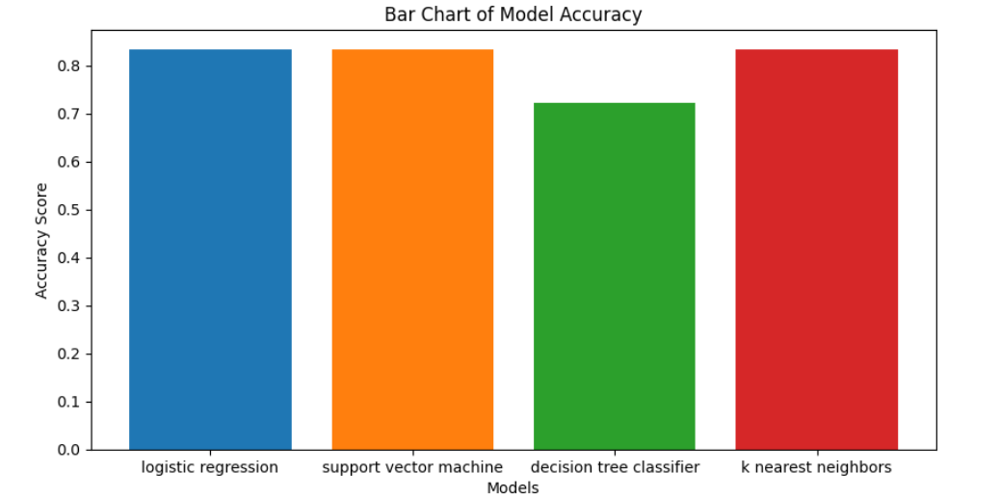
Classification Accuracy

Slide 44
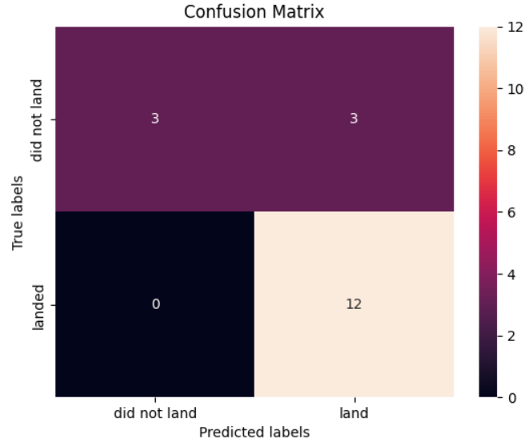

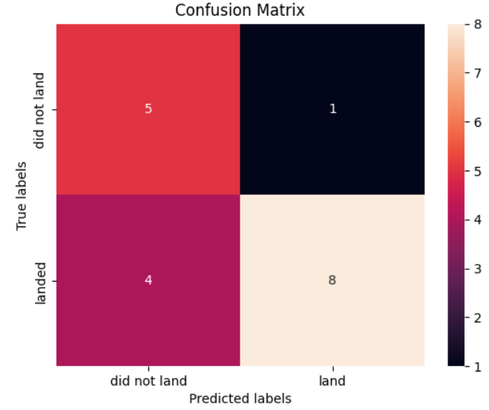
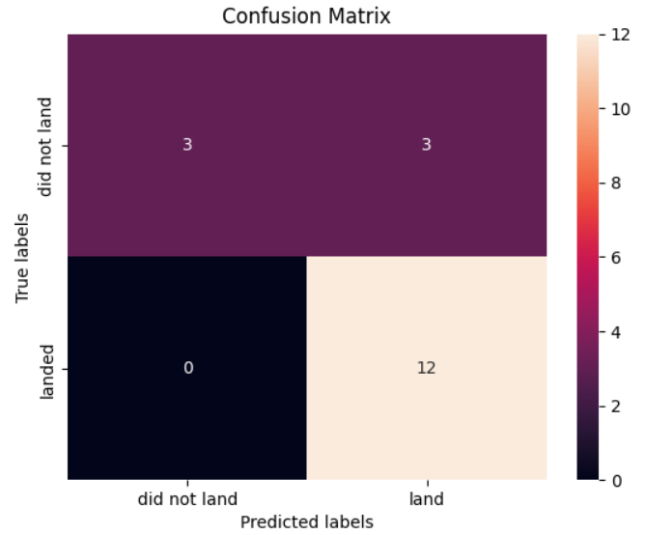
Confusion Matrix
The confusion matrix shows the number of True Positives and True Negatives along with the False Positives and False Negative.

Slide 45
Conclusions
• The SVM, KNN, and Logistic Regression models are the best in terms of prediction accuracy for this dataset.
• Low-weighted payloads perform better than heavier payloads.
• The success rates for SpaceX launches are directly proportional time in years they will eventually perfect the launches.
KSC LC 39A had the most successful launches from all the sites.
• Orbit GEO, HEO, SSO, and ES L1 has the best Success Rate.

Slide 46
Appendix
https://api.spacexdata.com/v4/launches/past
https://cf-courses-data.s3.us.cloud-object-storage.appdomain.cloud/IBM-DS0321EN-SkillsNetwork/datasets/API_call_spacex_api.json
https://en.wikipedia.org/w/index.php?title=List_of_Falcon_9_and_Falcon_Heavy_launches&oldid=1027686922
https://cf-courses-data.s3.us.cloud-object-storage.appdomain.cloud/IBM-DS0321EN-SkillsNetwork/datasets/dataset_part_1.csv
https://cf-courses-data.s3.us.cloud-object-storage.appdomain.cloud/IBM-DS0321EN-SkillsNetwork/datasets/dataset_part_2.csv
https://cf-courses-data.s3.us.cloud-object-storage.appdomain.cloud/IBM-DS0321EN-SkillsNetwork/labs/module_2/data/Spacex.csv
'https://cf-courses-data.s3.us.cloud-object-storage.appdomain.cloud/IBM-DS0321EN-SkillsNetwork/datasets/spacex_launch_geo.csv

Slide 47


